Slide 1


GATE BASED SYNTHESIS
OF INDEX GENERATION FUNCTIONS
Warsaw, 18.09.2019
Student: mgr inż. Dariusz WĄSICKI
Supervisor: prof. dr hab. inż. Tadeusz ŁUBA

Slide 2
SCHEDULE
Logic synthesis
Index generation unit
Attribute reduction
Decomposition
Linear vs. Functional decomposition
Conclusions
Next steps of researches

Slide 3
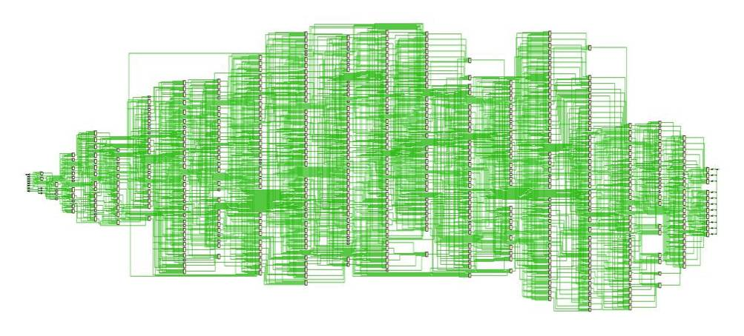
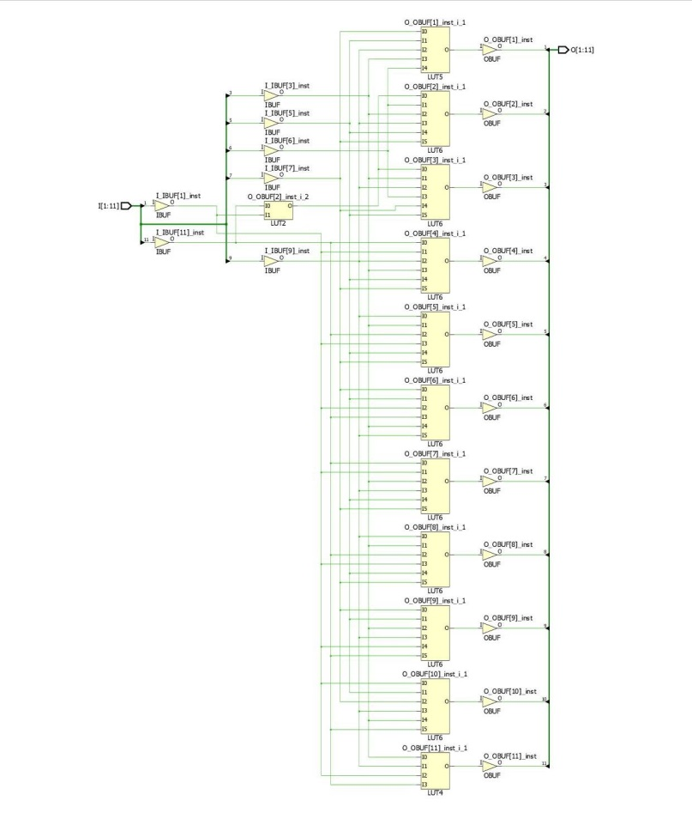
LOGIC SYNTHESIS
Attribute reduction & Decoposition
Notes:
Nowadays technical solutions faces the technical limitations related to the limited number of memory inputs used to implement decision systems.
That is why, scientific research is directed towards the logical synthesis of digital circuits.
To implement logic synthesis attribute reduction and decomposition metods are used.
The purpose/goal of these methods is to select the right data from a vast amount of unnecessary data.

Slide 4
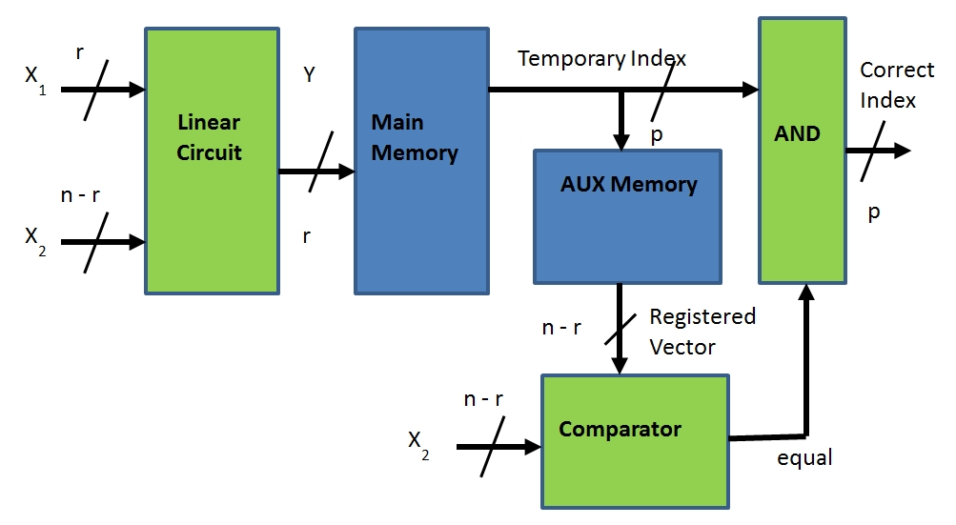
INDEX GENERATION UNIT
0110000100010000101001100001000100001010
0101111101101010001101011111011010100011
1111010101110111000011110101011101110001
0001111000010001011100011110000100010111
0011110000000100010100111100000001000101
0111001001000100100101110010010001001001
0010001110001111001000100011100011110010
1111111111010001111000100011100011110010
1110111000110001011011101110001100010110
1010000110100100001110100001101001000011
0000
1011
1111
1110
1010
0010
0100
1100
1101
0001
IGU
Notes:
Logic synthesis has the great meaing for synthesis of the index generation function (IGF) implemented by index generation unit.
It is common attribute reduction or decomposition is used to implement IGU .
Extracting the necessary data is difficult since the input data are usually binary vectors described by strongly unspecified Boolean functions with a significant number of arguments.
he logical synthesis is used the most common in:
IP address distribution,
virus scanning,
undesirable data detection,
code translation.

Slide 5
ATTRIBUTE REDUCTION
THE CLASSIC METHOD
THE COMPLEMENT METHOD
0110000100010000101001100001000100001010
0101111101101010001101011111011010100011
1111010101110111000011110101011101110001
0001111000010001011100011110000100010111
0011110000000100010100111100000001000101
0111001001000100100101110010010001001001
0010001110001111001000100011100011110010
1111111111010001111000100011100011110010
1110111000110001011011101110001100010110
1010000110100100001110100001101001000011
0000
1011
1111
1110
1010
0010
0100
1100
1101
0001
The Lightninng 2.1 application finds all possible reducts (more thean 100 000) in 292 sec.
and the smallest reducts (2261) in 1435 msec!
Notes:
Reducing attributes is the process of finding the smallest sets of arguments for Boolean functions for which data remain consistent.
The purpose/goal of these methods is to select the right data from a vast amount of unnecessary data.

Slide 6
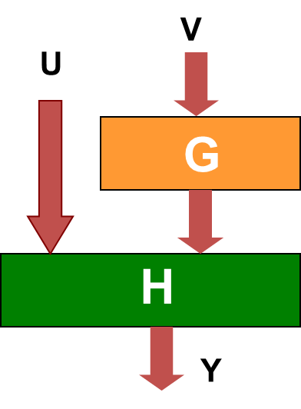
DECOMPOSITION
Linear
(EXOR gate based)
Functional
Decomposition
Attribute reduction
(x2 is reduced)
y₁ = x0 ⊕ x1 ⊕ x3 ⊕ x4,
y₂ = x3 ⊕ x4 ⊕ x6 ⊕ x7,
y₃ = x1 ⊕ x2 ⊕ x4 ⊕ x5,
y₄ = x4 ⊕ x5 ⊕ x7 ⊕ x8
y1 y2 y3 y4 f
1 0 0 0 1
1 0 1 0 2
0 0 1 0 3
1 1 0 0 4
1 1 1 1 5
0 0 1 1 6
0 1 0 0 7
0 1 0 1 8
0 0 0 1 9
0 0 0 0 10
Notes:
Decomposition is essential because it leads to a further reduction in the number of inputs in the IGU.
That’s why the decomposition is intensively used in the synthesis of the index generation function
There are a few decomposition methods described in the thesis:
The iterative improvement method;
The ambiguity method;
The polynomial method;
The method using the problem of liability;
The method based on the concept of the separating (distributing) function.
The most efficient is the method based on the concept of the separating (distributing) function

Slide 7
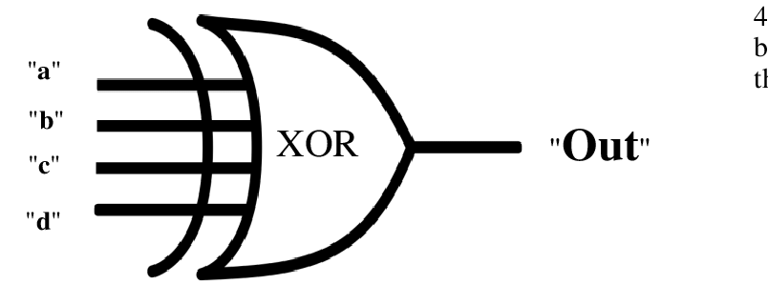
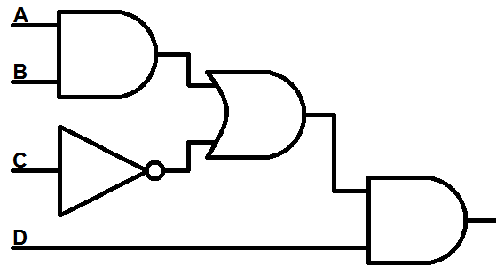
LINEAR VS. FUNCTIONAL DECOMPOSITION
MULTILEVEL DECOMPOSITION
Linear decomposition
Functional decomposition
OUT
Notes:
In the case of linear decomposition algorithms using EXOR gates, so re-invoking the algorithm increases only the number inputs.
This is a significant difference to the functional decomposition, where re‑calling the algorithm generates an additional one level of logic.
so the critical paths are longer and the same more complicated to hardware implementation.

Slide 8
CONCLUSIONS
Proposed order and methods of the stages of logic synthesis:
Attribute reduction
(the complement method);
Linear decomposition
(the method based on concept of distributing function);
Functional decomposition.
Notes:
For now my thesis shows that,
the most effective algorithms of logic synthesis are the complement method of attribute reduction
combined with the decomposition method based on the concept of the separating (distributing) function.
Attribute reduction allows to quickly eliminate redundant data, which helps to reduce the complexity of the decomposition calculations.
After using attribute reduction and linear decomposition (directly on EXOR gates), it is reasonable to subject the result to analysis for functional decomposition.
The above solution are not only the fastest, but also get the best results.

Slide 9
Next researches
Can synthesis consists of decomposition only be more efficient than synthesis consists
of attribute reduction and decomposition?
Finding sophisticated methods dedicated
to specialized systems.
Notes:
Currently, research is being carried out to check whether the attribute reduction stage can be omitted and replaced completely by decomposition.
Another direction of development in this field of science may be searching for algorithms adapted to the nature of the system, and hence less universal, but more efficient in a narrow spectrum of use.
However At the moment, the described algorithms are not only the most universal but also the fastest in a wide spectrum of use.

Slide 10
Thank you for attention
Dziękuję za uwagę
Спасибо за внимание
Notes:
Do you have any questions?

