Slide 1


COMPARATIVE ANALYSIS OF THE SELECTED IT PROJECT MANAGEMENT METHODOLOGIES
Student: Dzmitry Bahenski
Supervisor: Dr inż. Waldemar Łabuda
Warsaw 18.09.2019

Slide 2
Methodologies compared in Master Thesis
Every project is a unique event that cannot be standardized or put into separate frames!
There are a lot of project management methodologies. But for software projects the most popular methodologies nowadays are the following three:
PMI methodology (PMBOK),
Agile (SCRUM) methodology,
DevOps methodology

Slide 3
Master Thesis research is based on a real project!
The project was held in one of the biggest retail companies in Europe. Company was changing the POS (Point of Sales) system from Micros Technology (owned by Oracle) to a new Oracle POS product called Xstore.\
All the functions that have been individually adjusted, based on the needs of the company during 20 years, should be introduces in the new system.
The key objectives of the project were the follows:
To avoid the risk of the loss in sales due to inability to trade.
To remove the development constraints (only one developer knows all the details of the customized version of the current product).
To make it easier to deliver future propositions.

Slide 4

Brief description of the selected methodologies. Main aspects from the project point of view.
Delivering the Solution
Tooling | What tooling is required to support the end to end delivery
Testing | How will the solution be tested over the course of the project lifecycle
Deployment | How will the transition from the as-is to the to-be solution be held, both centrally and in the store
Training | What training will users be given to support the transition to the to-be solution
Service Introduction | How will the support team transition to the to-be solution

Slide 5
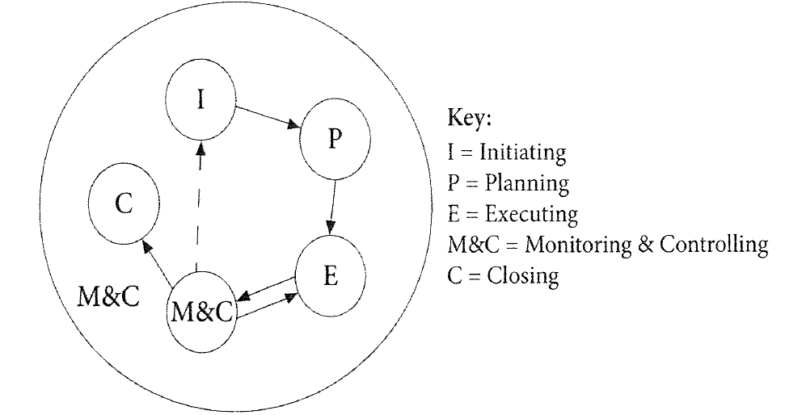
PMI (PMBOK) Methodology
Project management based on the PMI PMBOK standard allows you to choose the most suitable project format, depending on the complexity, urgency, importance, technology, number of participants, familiarity (routine) of the project characteristics. PMBOK covers 10 areas of the project: Integration, Content, Timing, Cost, Quality, Human Resources, Communication, Risks, Supplies, Stakeholders
Two main types of Project Structure:
Functional structure
Matrix structure
In general, when choosing a structure, there is a general dependence: simple, stable, routine, unlimited by strict time frames, it is more expedient to solve with the use of a weak matrix or functional structure. And vice versa - complex, urgent projects that require the mobilization of large human resources, it is more expedient to solve with the help of a strong matrix or project structures.

Slide 6
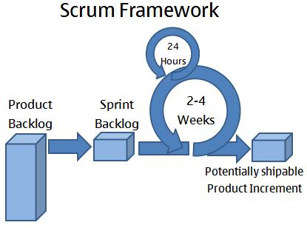
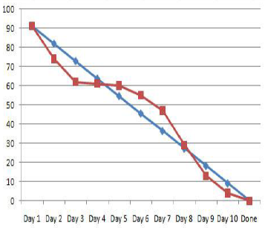
Agile (SCRUM) Methodology
SCRUM technology allows in rigidly fixed and small in time iterations, called sprints, to provide the customer with working software with new features for which the highest priority is defined.
Core elements of SCRUM are:
Sprints
Project backlog
Sprint backlog
Burndown chart
Sprint Planning Meeting
Daily SCRUM meeting
Sprint review meeting
Retrospective meeting

Slide 7
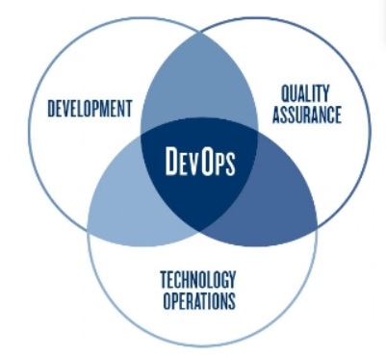
DevOps Methodology
DevOps tools typically fit into one or more of these categories, reflecting key aspects of software development and delivery:
Code - code development and analysis, version control tools, code merging;
Build - continuous integration tools, build status;
Test - continuous testing tools that provide feedback on business risks;
Package - repository of artifacts, pre-install the application;
Release - change management, release approval, release automation;
Configuration — Configuration and Infrastructure Management; Infrastructure as Code Tools;
Monitoring - monitoring application performance, experience with the end user.

Slide 8
Comparison of Methodologies
PMBOK | DevOps | Agile SCRUM
Project Integration Management
Development of the project charter Development of a preliminary report on the project. Develop a project management plan. Monitoring and management. Change control. Closing a project. | Integrate software as soon as possible and more often. Ownership of the collective code. Measuring the speed of the project. | Verification of approval and funding management at the planning stage. Strong change management procedure. System architecture to support change
Project management
Planning. The definition of the area. Creating a structure and breakdown work (WBS). Control. | User stories Release planning. | Perform analysis to build domain models. Development by product backlog list. Determining the functionality that will be included in each version of the product
Project Time Management
Sequencing. Resource assessment. Duration of action. Schedule development and control. | Release planning. Planning iterations. | Determining the delivery date of functionality for each version. Monthly iterations
Project Cost Management
Cost estimate. Cost budgeting. Cost control project. | Not provided. | Estimation of the value of the issue at the planning stage.
Project Quality Management
Quality planning. Perform quality control. | Use project standards. Quality is based on simplicity. | Project Review Meeting. Sprint planning meeting. Daily meetings.
Management of risks
Risk management planning. Risk identification. Qualitative risk analysis. Risk control | Prototype to limit risk. | Initial risks during planning. Review of risks during meetings.

Slide 9
Weighted Average Analysis
I introduced weight scale for each of the parameters in the range from 0 to 5 points, where 0 is not important to the project, 5 is extremely important for the project. The points are given by 3 experts, who were working on the project. Areas that were analysed are:
Project Integration Management
Project management
Project Cost Management
Project Quality Management
Management of risks

Slide 10
Weighted Average Analysis
Here are the results of analysis conducted among 3 project participants Project Manager, Development Lead and Solution Architect.
Agile SCRUM
Mark, x | Quantity, f
5 | 6
4 | 12
3 | 0
x̄ = 5*6 + 4*12 + 3*0 / 5+4+3 = 6,5
PMBOK
Mark | Quantity, f
5 | 3
4 | 10
3 | 5
x̄ = 5*3 + 4*10 + 3*5 / 5+4+3 = 5,8333
DevOps
Mark | Quantity, f
5 | 12
4 | 6
3 | 0
x̄ = 5*12 + 4*6 + 3*0 / 5+4+3 = 7

Slide 11
Conclusion
The project was challenging particularly due to the reason that a system used previously was heavily customised during 20 years of use in business and these features, tailored for one particular customer, were to be kept in a new system
Using weighted averages method, it can be concluded that DevOps method is judged as the best in Project Integration Management, Project Time Management, Project Cost Management, Project Quality Management, and Management of risks categories, while in Project Management it is on par with Agile Scrum as the leading approach.
The favorable view of DevOps was shared by two participants, while project manager preferred both PMBOK and Agile Scrum over it. It could be explained by the fact, that project approach of PMBOK is well-known and familiar to Project manager. It allows to achieve better control over the project. While technical and development parts better appeal to flexible Agile and DevOps.
DevOps was, overall, judged equally well in every category, while PMBOK weak spots were Project Integration Management, Project Cost Management and Project Quality Management, and Agile Scrum performed somewhat weaker in Management of risks.
This assessment is concerning one particular project, sheds a light on an issue of choosing the most approach project management approach in software development. It is suggested that DevOps might be the best option among common frameworks, as the other popular approaches have their weaknesses that might impact the realization of the project.

Slide 12
Thanks for Your attention!
And for all these 2 years of studies!!!

